Slide 1

ViNet: Pushing the limits of Visual Modality for Audio-Visual Saliency Prediction Samyak Jain, Pradeep Yarlagadda, Shreyank Iyoti, Shyamgopal Karthik, Ramanathan Subramanian, Vineet Gandhi Published on December 2020
Presenters:
Allegra Martina & Susanna Saitta

Slide 2
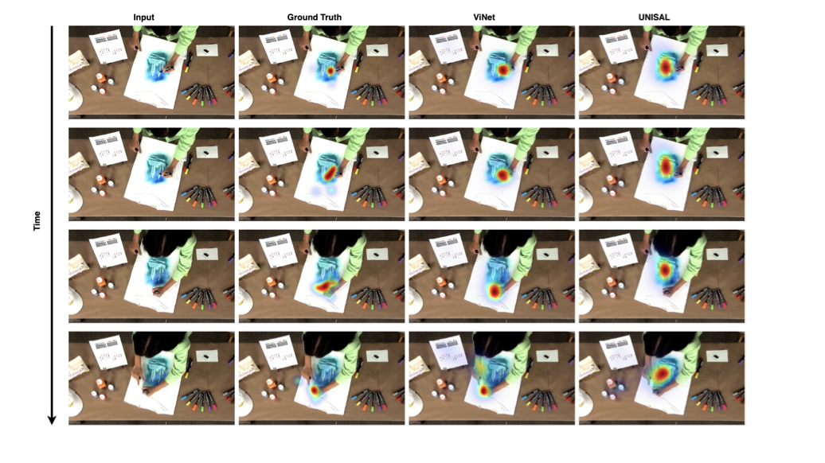
Motivation
Video saliency prediction focuses on understanding and modelling human visual attention (HVA) while viewing a dynamic scene.
They propose the ViNet architecture for audiovisual saliency prediction; the model achieves state-of-the-art results on audio-visual saliency datasets without using any audio information.
Since cognitive studies confirm that auditory and visual cues are correlated and jointly contribute to human attention, they experiment an audio-visual saliency prediction model obtained by augmenting ViNet with an audio branch.
The resulting architecture called AViNet.

Slide 3
Research contributions
Amalgamation of commonly deep learning components.
Comprehensive analysis on ten different datasets.
Explore audio-visual fusion for SP.

Slide 4
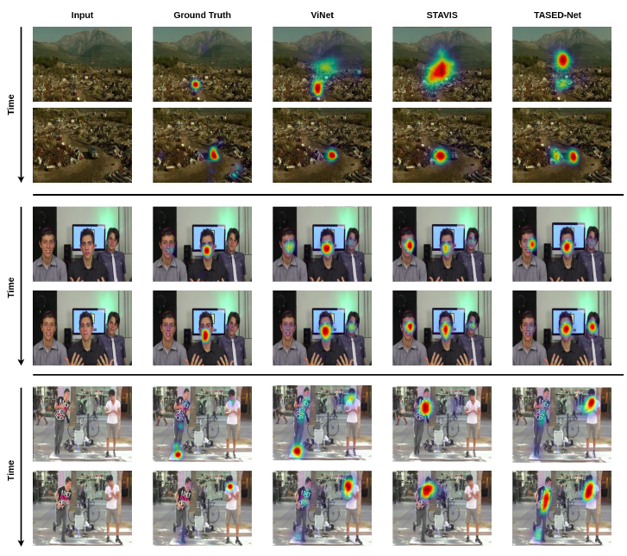
State of the art
Majority of the recent approaches rely on an LSTM based architecture, i.e. UNISAL, for sequential fixation prediction over successive frames.
Limitation: fail to jointly process spatial and temporal information.
To overcome this limitation, 3D convolutional architecture, i.e. TESED-Net, has been introduces. These methods typically rely on action detection networks as their backbone.

Slide 5
Proposed approach – Overall idea
They propose an end-to-end architecture visual-only model called ViNet.
It is a fully 3D-convolutional encoder-decoder architecture that predicts the saliency for the last frame of the corresponding set of sequential frames.
Then, they present an audio-visual saliency detection model called AViNet that fuses the visual features from ViNet and audio features from SoundNet.

Slide 6
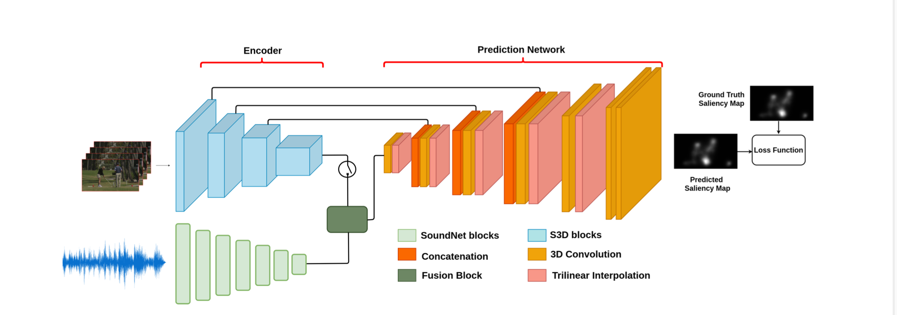
Model architecture
Let’s see in detail:
Backbone - Encoder
Audio-visual Fusion
Prediction Network - Decoder
Evaluation
Loss Function

Slide 7
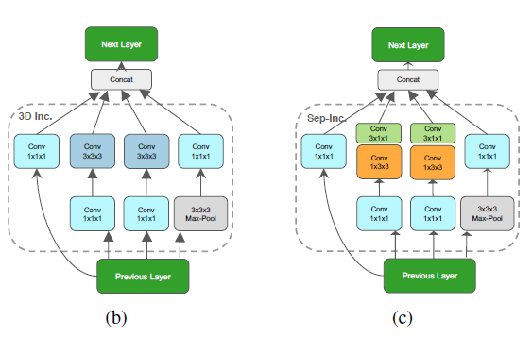
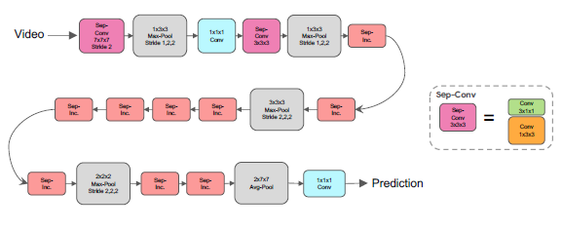
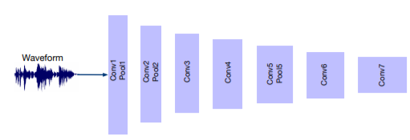
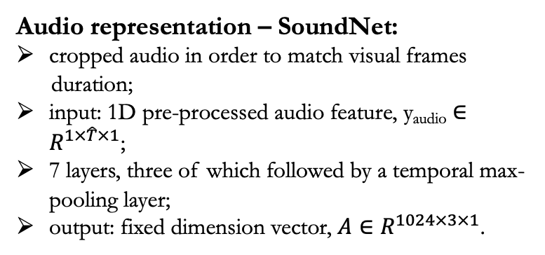
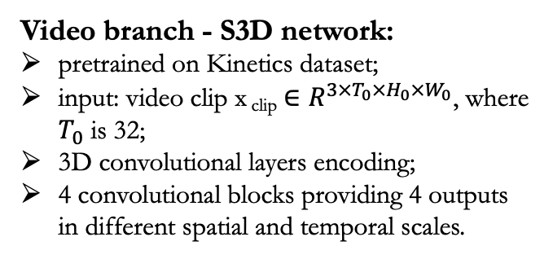
Model architecture - Encoder
S3D
X₁
X₂
Video branch - S3D network:
pretrained on Kinetics dataset;
input: video clip x _{clip} $∈R^{3×T_{0}×H_{0}×W_{0}}$, where $T_{0}$ is 32;
3D convolutional layers encoding;
4 convolutional blocks providing 4 outputs in different spatial and temporal scales.
Sep-Conv.
7x7x7
Stride 2
Max-pool
1x3x3
Stride 1,2,2
1x1x1
Conv
Sep-Conv
3x3x3
Max-pool
1x3x3
Stride 1,2,2
Sep-Inc
Sep-Inc
Video
X₃
Sep-Inc
Sep-Inc
Sep-Inc
Sep-Inc
Sep-Inc
Max-pool
3x3x3
Stride 2,2,2
Max-pool
2x1x1
Stride 2,1,1
Max-pool
1x2x2
Stride 1,2,2
Sep-Inc
Sep-Inc
X₄
where:
Audio representation – SoundNet:
cropped audio in order to match visual frames
duration;
input: 1D pre-processed audio feature, y_{audio} $∈R^{1×\hat{T}×1}$;
7 layers, three of which followed by a temporal max-pooling layer;
output: fixed dimension vector, $A∈R^{1024×3×1}$.
SoundNet

Slide 8
Model architecture – Audio-visual fusion
A simple concatenation of encoded audio and video features is used.
In detail:
audio features are repeated to match the dimensions of visual features;
audio and video features are combined across the channel dimension;
a 1x1 Convolution is applied to reduce the number of channels.

Slide 9
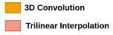
Model architecture – Decoder
There are 6 decoding layers consisting of 3D convolutional and upsampling layers using trilinear interpolation.
Input for ViNet: X₄ features from the Backbone + X₃,X₂, and X₁ using skip connections.
Input for Avinet: audio features fused with X₄ and then sent to the decoder + skip connections.

Slide 10
Model architecture – Evaluation
Both ViNet and AViNet follow a sliding window approach to generate a saliency map for all frames in the video.
This approach assumes that the saliency map of any frame can be predicted by considering a limited number of past frames.
Given a window size of T frames, where T = 32, they predict saliency map S_{t} at time step t by taking F_{t-T+1,} .., F_{t} sequence of frames as input.
To enable prediction in the first T frames, they simply repeat the first frame of the video at the start.

Slide 11
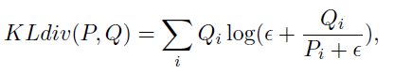
Loss Function
Employed loss is the Kullback-Leibler Divergence, which is an information-theoretic measure of the difference between two probability distributions:
Where:
- P is the distribution of the predicted maps;
- Q is the distribution of the ground truth maps;
- ε is the regularization term.

Slide 12
Experimental results - Datasets
Visual dataset
DHF1K - 1000 videos in total. 700 of the videos are annotated, 600 for training and 100 for validation. The remaining 300 are the testing set. Content: a large range of scenes, motions, object types, and background complexity.
Hollywood-2 - 1707 videos: 823 training videos and 884 test videos. Content: short video sequences from a set of 69 Hollywood movies, containing 12 different human action classes.
UCF-Sports - 150 videos: 103 videos for training and 47 videos for testing. Content: human actions in sports.
Audio-visual dataset
DIEM - 81 movie clips: 64 training videos and 17 test videos. Content: movie clips of varying genres, i.e. advertisements, documentaries, game trailers.
Coutrot databases - Coutrot1: 60 clips. Content: dynamic natural scenes split into four visual categories: one and several moving objects, landscapes, and faces. Coutrot2: 15 clips. Content: 4 persons in a meeting and the corresponding eye-tracking data from 40 persons.
AVAD dataset - 45 short clips. Content: audio-visual scenes, e.g., dancing, guitar playing, birds singing, etc.
ETMD - 12 videos. Content: from six different hollywood movies.
SumMe dataset - 25 unstructured videos. Content: mostly user-made videos and their corresponding multiple human created summaries, which were acquired in a controlled psychological experiment.

Slide 13
Experimental results - Metrics
CC – Pearson Correlation Coefficient. It is generally used for measuring how correlated or dependent two variables are. CC can be used to interpret saliency and fixation maps, P and Q^{D}, as random variables to measure the linear relationship between them.
NSS - Normalized Scanpath Saliency. NSS is a metric that involves a saliency map and a set of fixations; it measures the average normalized saliency values at fixation locations along a subject’s scanpath. It is a discrete approximation of CC that is additionally parameter-free.
SIM - Similarity metric measures the similarity between two distributions, viewed as histograms. It performs a simple comparison between pairs of saliency maps. SIM is computed as the sum of the minimum values at each pixel, after normalizing the input maps.
AUC - Area under ROC curve. AUC treats the saliency map as a binary classifier of fixations at various threshold values, and an ROC curve is swept out by measuring the true and false positive rates.

Slide 14
Experimental results –Training procedure
Training set up:
clip with 32 consecutive frames randomly selected;
each frame resized to 224x384 and normalized;
batch size of 8;
batch normalization;
Adam optimizer;
learning rate of 0.0001.
ViNet training:
It is initially trained on the DHF1K dataset and the validation set is used for early stopping.
The trained model is fine-tuned on Hollywood-2 and UCF-Sports dataset and their test sets are used for early stopping.
AViNet training:
Weights of ViNet pre-trained on DHF1K are used and fine-tuned on the audio-visual datasets.

Slide 15
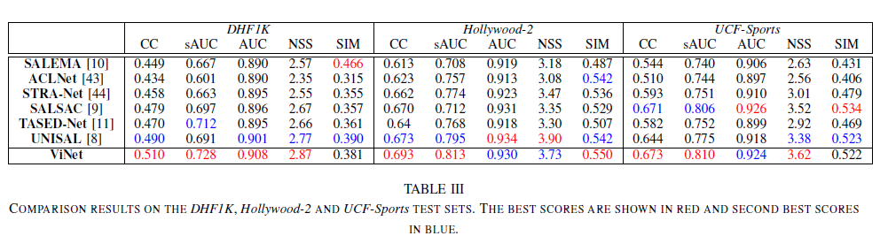
Experimental results – Comparison with the state of the art
Visual-Only datasets:
The best scores are shown in red and second best scores in blue.
ViNet outperforms all the state-of-the-art models on the DHF1K dataset and achieves top results on most metrics on Hollywood-2 and UCF-Sports datasets.

Slide 16
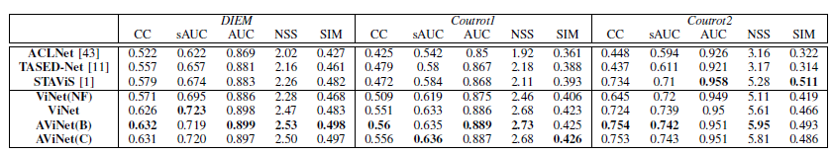
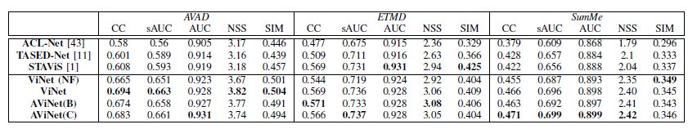
Experimental results – Comparison with the state of the art
Audio-Visual datasets:
ViNet(NF): trained on DHF1K, not fine-tuned on audio-visual datasets.
AViNet(B): AViNet with bilinear fusion.
AViNet(C): AViNet with concatenation.
Only STAViS and AViNet models make use of the audio modality.
In contrast to previous works, like Stavis, the experimental results do not indicate any clear benefit of incorporating audio in the prediction pipeline.

Slide 17
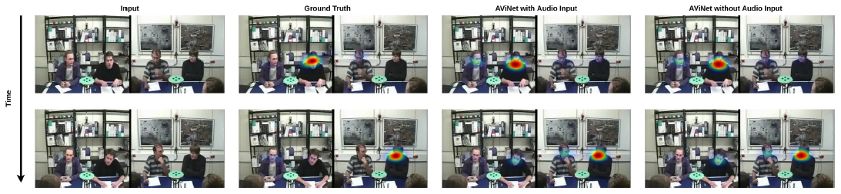
Experimental results – The impact of audio
To investigate more on the role of audio in AViNet and STAViS, they send zeroed-out vector as audio.
Surprisingly, prediction maps obtained with and without audio are nearly identical.
In summary, the current state-of-the-art audio-saliency models end up learning a visual-only model.

Slide 18
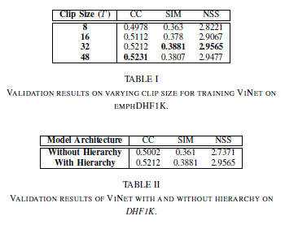
Experimental results – Ablation studies
Ablation studies in ViNet:
changing the clip size;
using multi-level features;
replacing upsampling with transpose convolutions;
applying two different concatenation techniques for fusing, across temporal dimension and channel dimension.

Slide 19
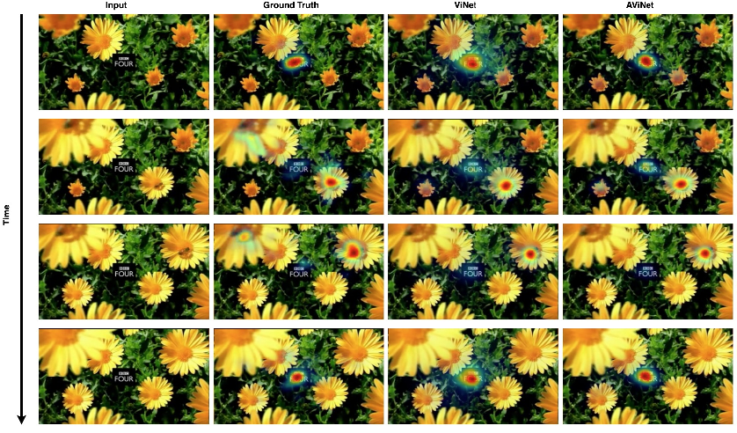
Conclusions
ViNet, a novel spatio-temporal visual-only architecture, efficiently addresses the problem of saliency detection in videos and brings significantly gains over the state-of-the-art models.
AViNet incorporates audio for the task by the addition of an auditory module to ViNet.
However, audio does not seem to be playing a major role in audio-visual saliency prediction.

Slide 20
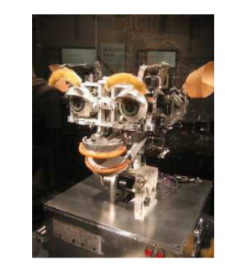
Applications
Human-robot interaction - A robot that orients its eyes in a manner
similar to humans is likely to give an impression of intelligent behavior
and facilitate interaction with humans.
Video captioning - Saliency prediction model could help identify which
parts to focus on when generating a caption.
Automated cinematic editing - SP is useful to capture interesting scene content. Indeed, gaze is employed to select shots for inclusion in the edited video.

Slide 21
Thanks for your attention!

